Slide 1

The Relationship of Economic Development & The Products
Shuhang Zhou

Slide 2

INDEX
Introduction of the views
The building blocks of economic complexity
The product space conditions the development of nations

Slide 3
The view and two mainstream approachs
The type of product a country exports will influence the economic performance
David Ricardo(economist in 19th century)
Britain------cloth Portugal------wine
Lacking of models

Slide 4
The view and two mainstream approachs
The first approach focuses on the relative proportions in which countries possess productive factors and the proportions in which these factors are needed to produce different goods
Poor------labor and land
Rich------human and physical capital

Slide 5
The view and two mainstream approachs
The second approach emphasizes technological differences and therefore needs to be complemented with a theory of what may lie behind these differences and how they may evolve over time.

Slide 6
Development of Eurasia and America
climate changes little with longitude but greatly with latitude, domesticated plants and animals can diffuse more easily if they travel east or west than if they travel north or south.
more products were available to the Eurasians than to the Amerindians and Africans.

Slide 7
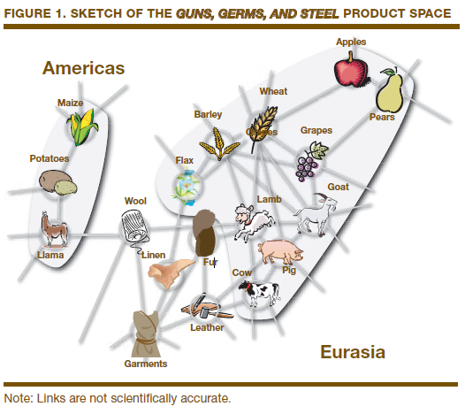

Slide 8
How influence
Technology or skill
Source materials
diplomacy or trading
return to Index

Slide 9
The Legos model
A product is equivalent to a Lego model, and a country is equivalent to a bucket of Legos. Countries will be able to make products for which they have all of the necessary capabilities, just like a child is able to produce a Lego model if the child’s bucket contains all of the necessary Lego pieces.

Slide 10
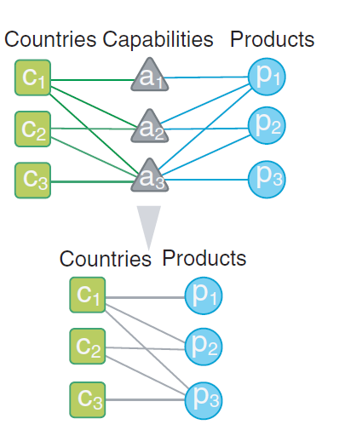
The Legos model
How to omit the capabilities to build the bipartite network connecting countries to products

Slide 11
Important definition of M_{cp}
M_{cp}=1 if country c is a significant exporter of product p and 0 otherwise
significant exporter(RCA_{cp}>=1)
RCA(Revealed Comparative Advantage)
the share of product p in the export basket of country c to the share of product p in world trade

Slide 12
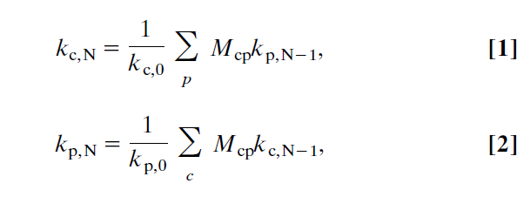
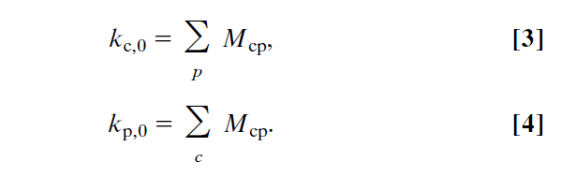
Method of Reflections
The diversity of a country
The ubiquity of a product

Slide 13
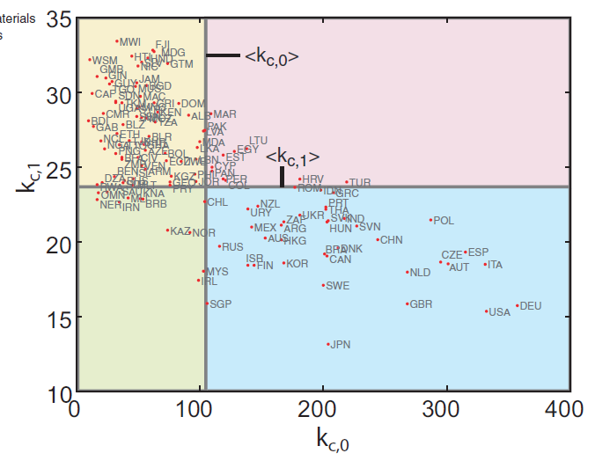
The first two sets of variables
The diversified countries tend to export less ubiquitous products.

Slide 14
Conclusion of the picture
This shows that more diversified countries indeed produce more complex(or special) products, in the sense that they require a wider combination of human capabilities, and that k_{c} is able to capture this information.

Slide 15
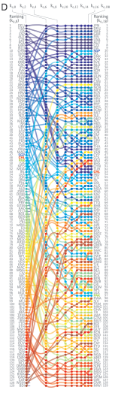
K_{c} ranks of countries in 2000
The k_{c} ranks of 129 countries that show from k_{c,0} k_{c,2} k_{c,4} ... k_{c,18} ,we can find that the rank is almost convergent especially the top ranks.

Slide 16
How it work
This can explain that why 3 countries that exported a similar number of products in the year 2000, albeit having large differences in income.
SGP(Singapore) 47 to 10 (20)
CHL(Chile) 48 to 53 (55)
PAK(Pakistan) 49 to 97 (151)

Slide 17
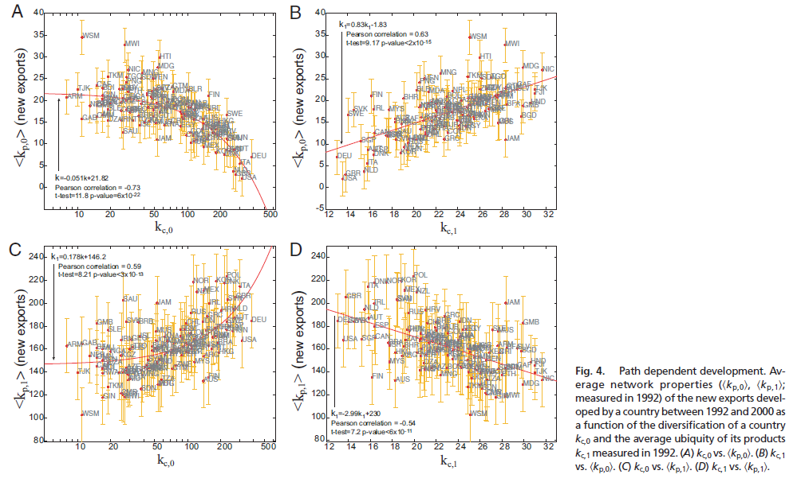
Effective for prediction
Return

Slide 18
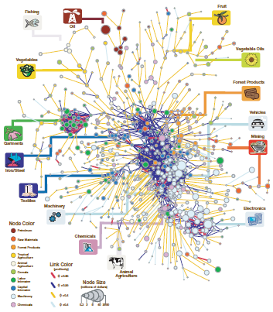
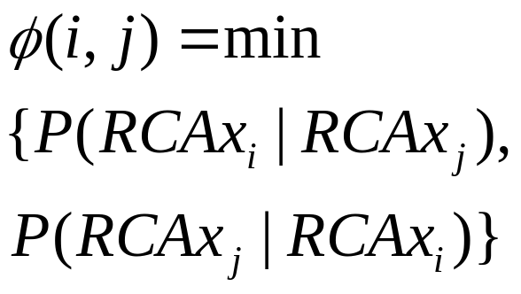
Product space
The concept of proximity

Slide 19
The characteristic of product space
1 Core-periphery structure
2 Clustered
We can see that product space structure is heterogeneous, in a sense, the product space structure explain the economic structure.

Slide 20
The diffusion of nations
What's diffusion?
Assume that the product space is stationary and the nations diffuse from some products to another products, it looks like the nations walk in the product space.
It represent the direction of development of nations.

Slide 21
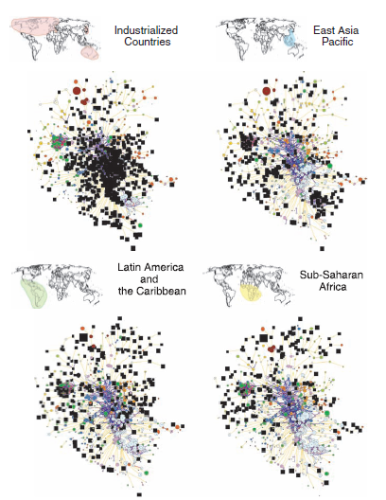

Slide 22
The conclusion of picture
Industrialized countries occupy the core, composed of machinery, metal products, and chemicals. They also participate in more peripheral products such as textiles, forest products, and animal agriculture. East Asian countries have developed RCA in the garments, electronics, and textile clusters, whereas Latin America and the Caribbean are further out in the periphery in mining, agriculture, and the garments sector.

Slide 23
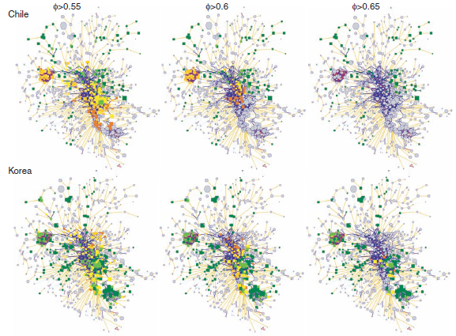

The result of testing diffusion

Slide 24
Conclusion
These findings have important consequences for economic policy, because the incentives to promote structural transformation in the presence of proximate opportunities are quite different from those required when a country hits a dead end. It is quite difficult for production to shift to products far away in the space, and therefore policies to promote large jumps are more challenging. Yet it is precisely these long jumps that generate subsequent structural transformation, convergence, and growth.

Slide 25
That's all thank you!

